Slide 1
Step Into Java:
ArrayList Class
Mr. Neat
Java

Slide 2

What are the limitations of
an array?

Slide 3
Limitations of arrays
1) cannot be resized
2) all values must be the same type
- ints
- doubles
- boolean
- objects from one class

Slide 4
The ArrayList Class!
- Holds an array of Objects
- Can be resized
- Objects can be from different classes!

Slide 5




Could have an ArrayList
object that looks like this:
“school”

Slide 6
java.utils.ArrayList is the
library class that must be
imported.

Slide 7
import java.utils.ArrayList;
public class PlayArray
{
private ArrayList myList = new ArrayList();
constructs an ArrayList object
with zero elements

Slide 8
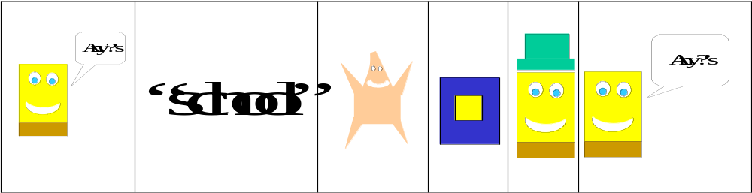
public ArrayList Methods
int size()
boolean add(Object x)
Object get(int index)
Object set(int index, Object x)
Object remove(int index)
void add(int index, Object x)
myList.size()
myList.add(“Hi”);
myList.get(4);
myList.set(3,”Bye”);
myList.remove(2);
myList.add(3,new SpongeBob….);
myList

Slide 9
How does the ArrayList
resize?

Slide 10
Bad News…
Since ArrayList is a list of
Objects, these are what is
returned by the methods.
For example,

Slide 11
ArrayList aList = new ArrayList();
aList.add(“Chris”);
String joe = aList.get(0);
System.out.println(“My Name is “ + joe);
What happens?

Slide 12
What type does the get
method return?

Slide 13
String joe = Object tom?
Remember inheritance...

Slide 14
Object
String
String “is-a” Object
Object tom = String joe;
// this is ok!

Slide 15
How do we turn our returned
Object into a String?
Casting….you have seen this
before.

Slide 16
String joe = (String)aList.get(0);
This “casts” the returned
Object by get into a
String object.

Slide 17
One other problem…
what if we wanted an
ArrayList of int’s, or
double’s?
But ArrayList holds Objects!

Slide 18
Wrapper Classes to the rescue!
These classes turn primitive
types into classes. We are
concerned about 3:
Double
Int
Boolean

Slide 19
Construct a Double object:
Double r = new Double(7.5);
// to retrieve the double value,…
System.out.print(r.doubleValue());

Slide 20
Let’s add a double value to
aList:
double num = 37.5;
Double numWrap = new Double(num);
aList.add(numWrap);

Slide 21
How would you retrieve
the Double in aList?
Now its an Object….

Slide 22
Double retriever = (Double)aList.get(0);
double back = retriever.doubleValue();

Slide 23
Next Lab
- Repeat CDSRUS using an ArrayList data
structure.
- Have 1 ArrayList of CD’s
- The output should be the same as your
first assignment (just implemented
differently).

